Slide 1
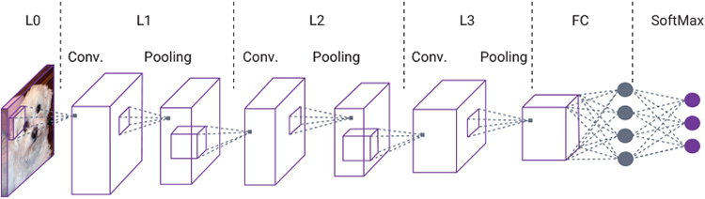
Convolutional Neural Networks for Image Classification

Slide 2
Introduction
Recognizing photos is one of the most common problems, and it is also important in image search engines such as Google or AliExpress where the user uses image contents to query for similar things.

Slide 3
Objective
The goal of this project is to build a deep learning model that can recognize object in images and predict the class of the image.

Slide 4
Dataset
I use CIFAR-10 dataset consists of 60,000 32x32 pixels color images in 10 classes. The 10 different classes represent airplanes, cars, birds, cats, deer, dogs, frogs, horses, ships, and trucks, in which each of those classes consists of 6000 images.
There are 50,000 training images and 10,000 test images.
dataset is already available in the datasets module of Keras you can directly import it from keras.dataset or download it from https://www.cs.toronto.edu/~kriz/cifar.html

Slide 5
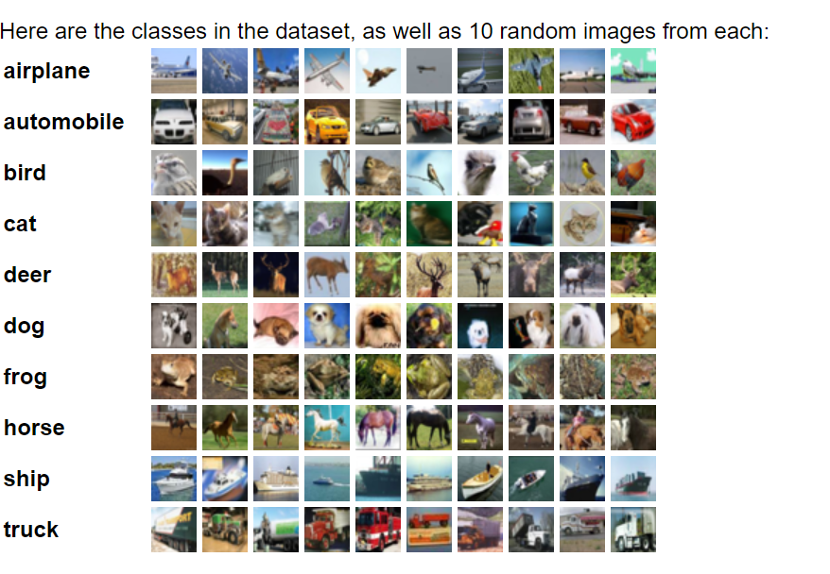
The CIFAR-10 dataset

Slide 6
Tools
NumPy for data manipulation.
TensorFlow, Keras, Scikit-learn for modeling.
Matplotlib for visualizations.

Slide 7
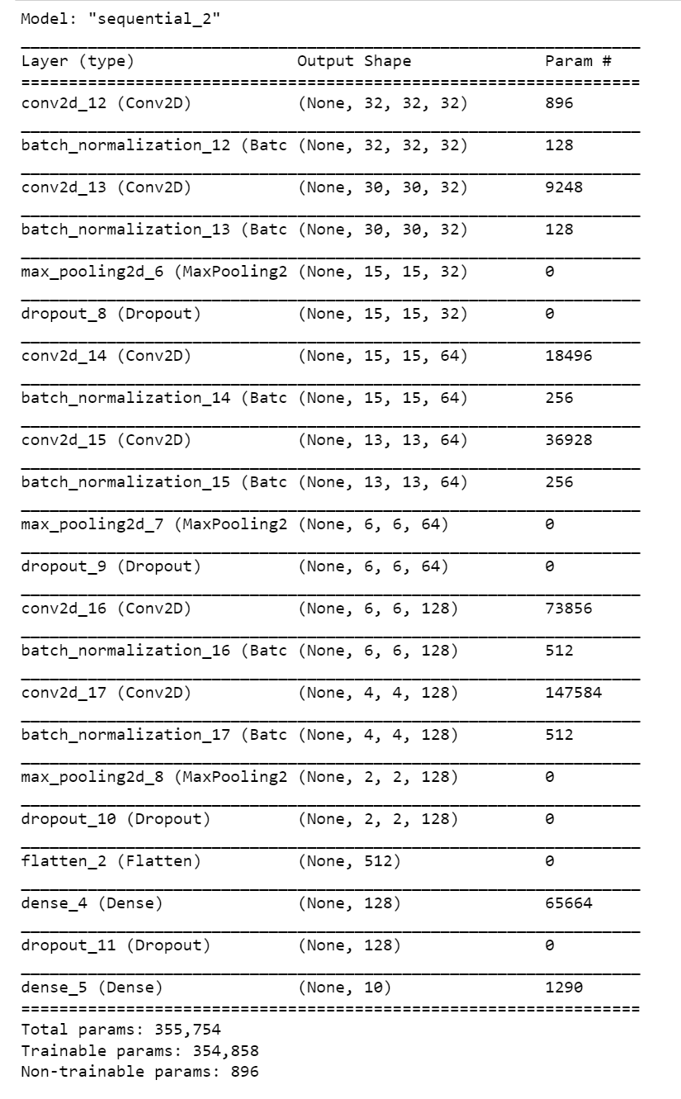
Model Architecture

Slide 8
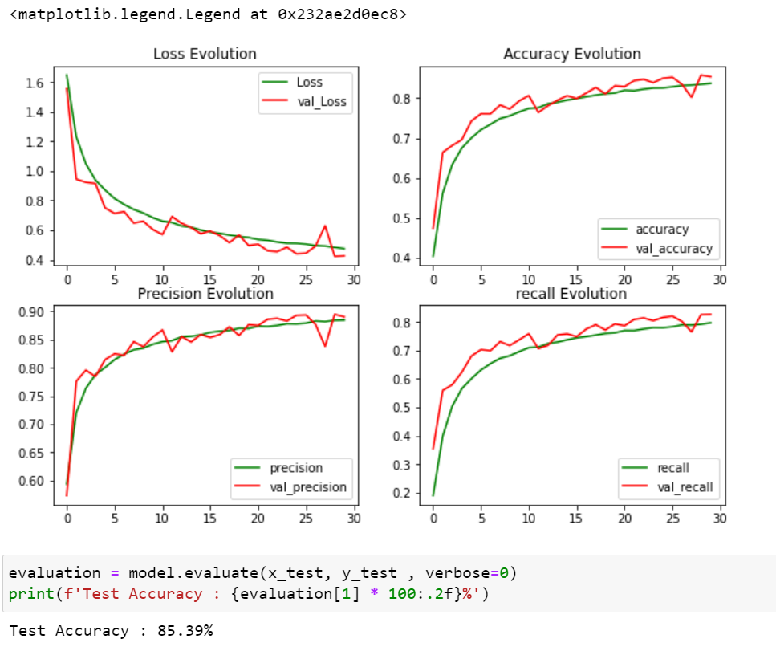
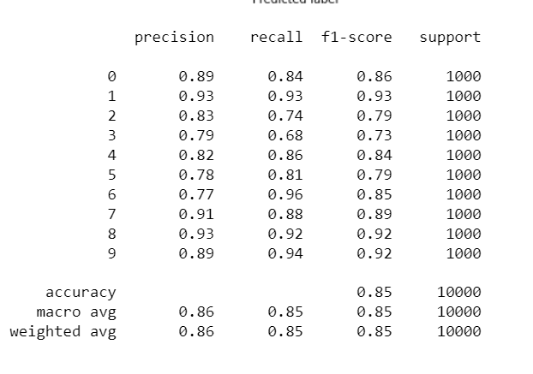
Evaluation

Slide 9
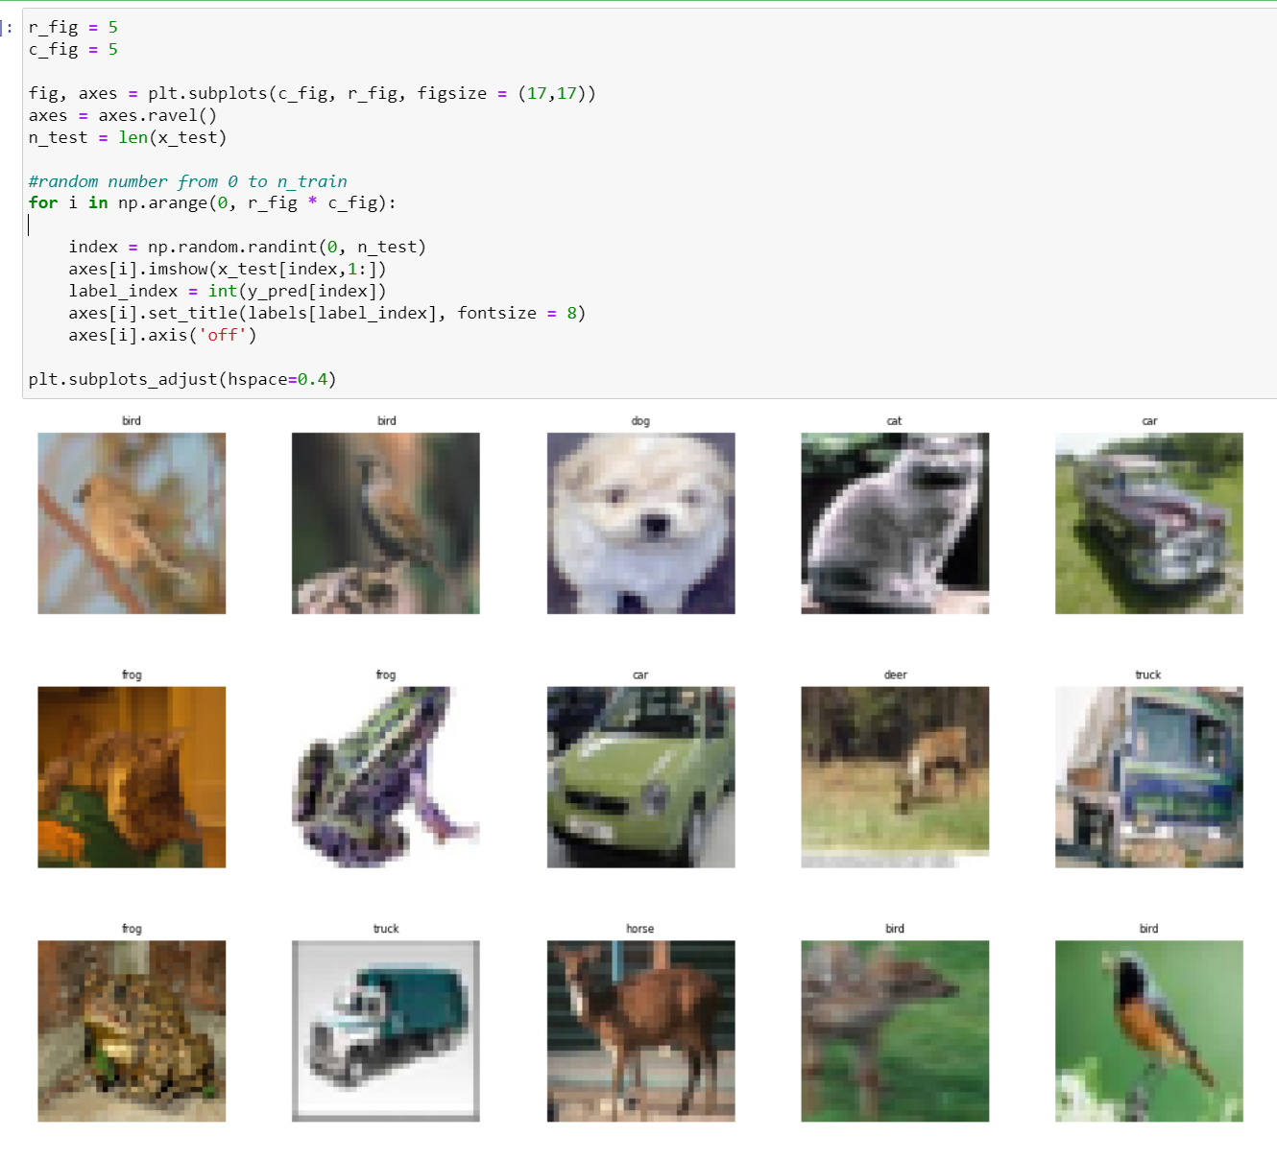
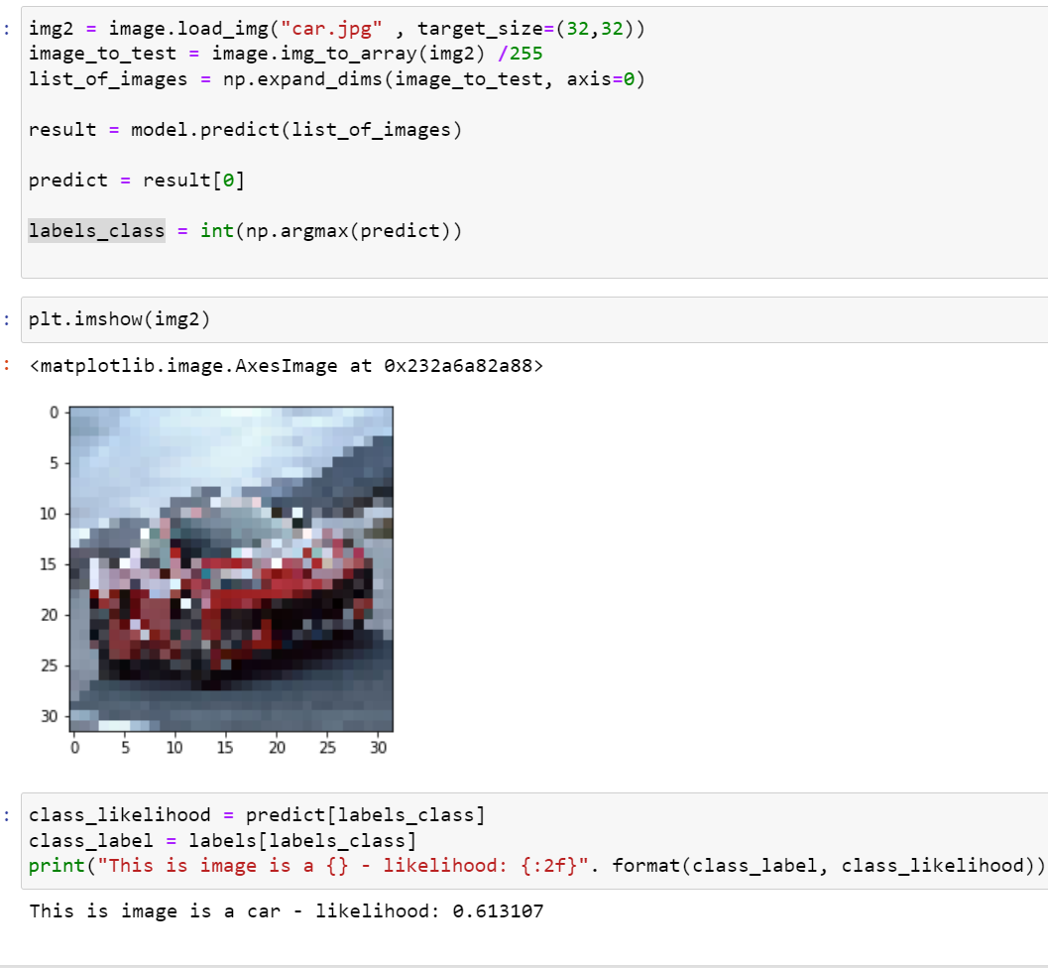
Testing

Slide 10
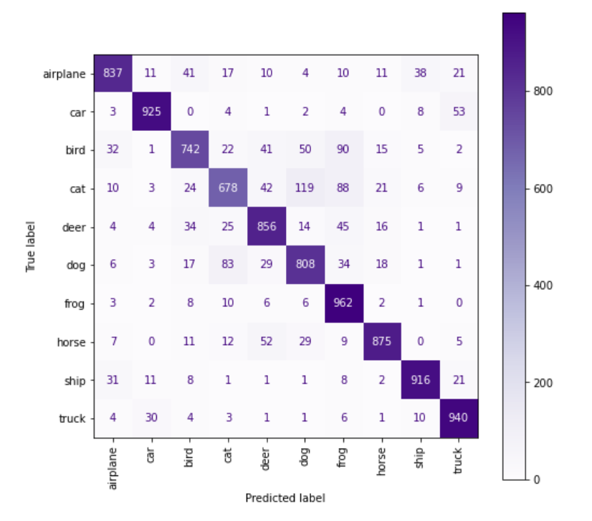
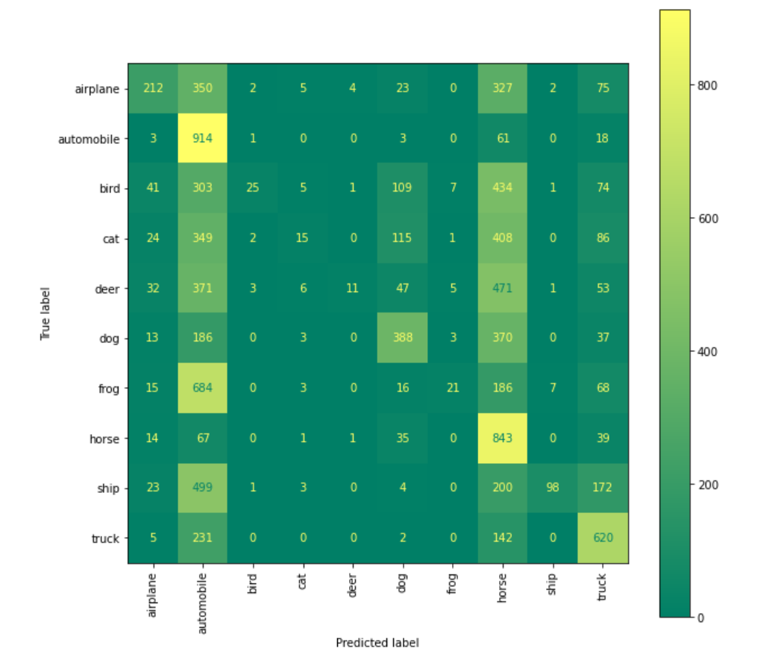
Heatmap
Figure1 : after using data augmentation
Figure2 : before using data augmentation

Slide 11
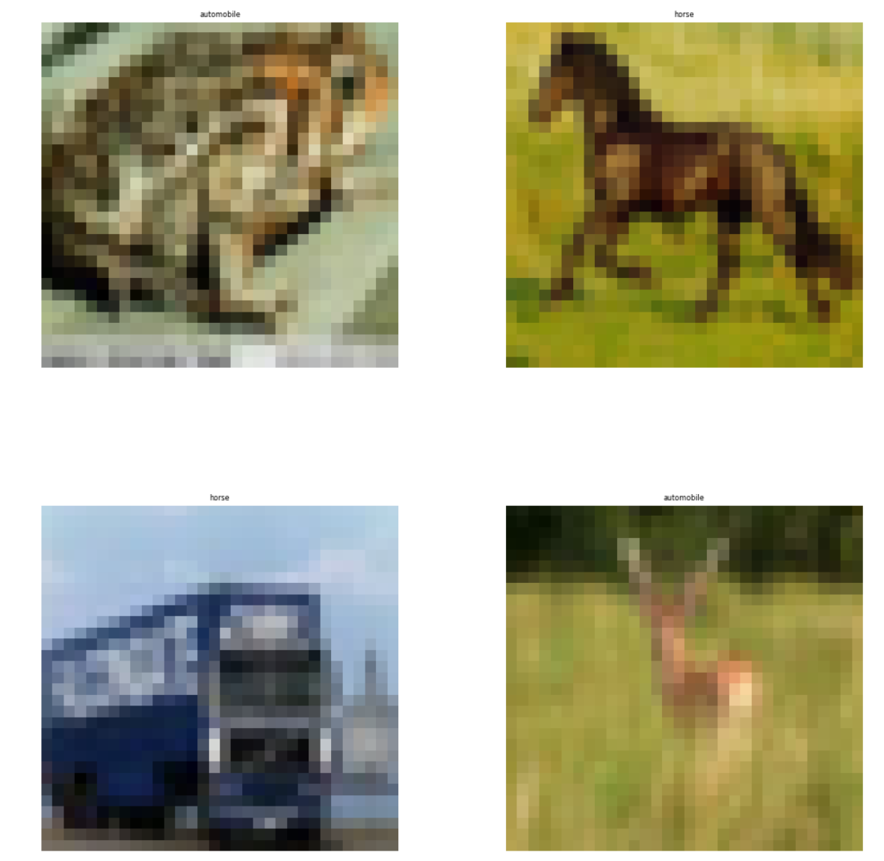
Prediction before using data augmentation

Slide 12
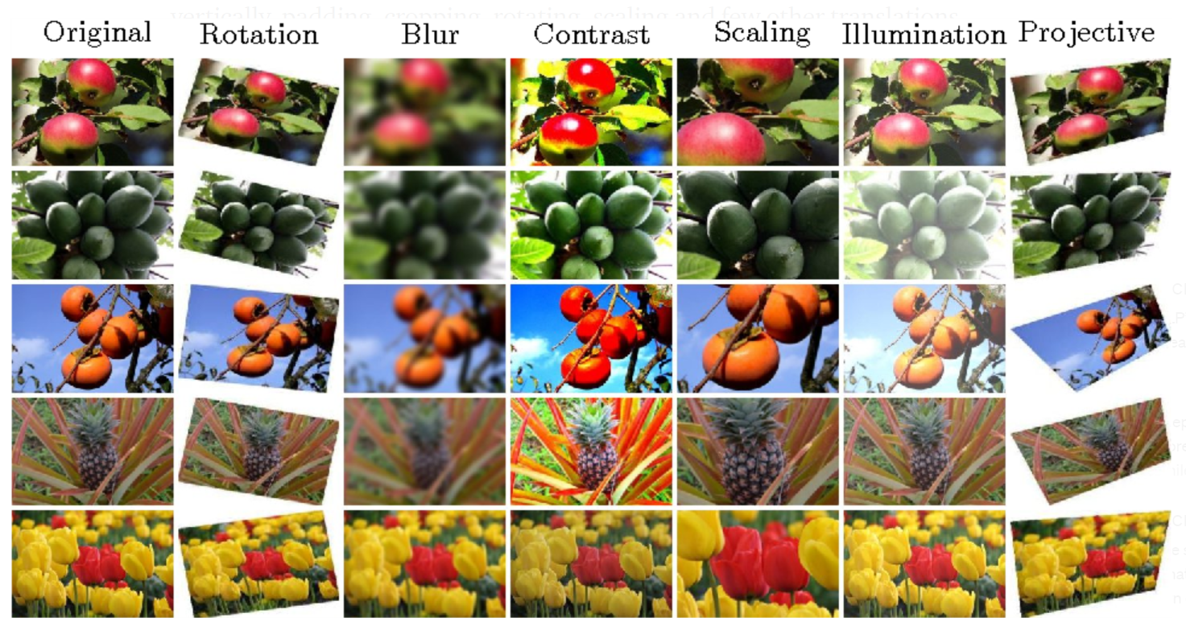
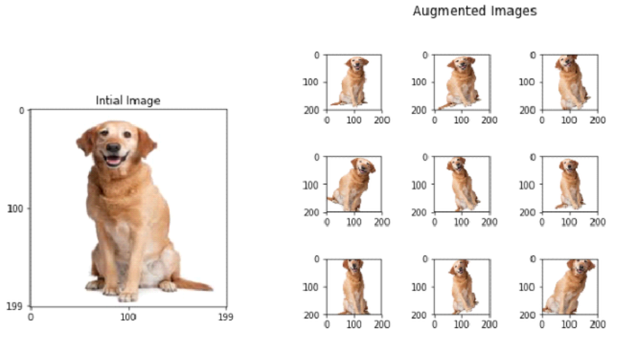
Data Augmentation techniques

